Slide 1

ALCOHOL AND LIFE EXPECTANCY
An analysis between life expectancy and alcohol consumption by country

Slide 2
Team members
Michele Beltrán
José Antonio Cerda
Laura Escamilla

Slide 3
Table of contents
Selected Topic
Technologies, languages, tools
Data source
Database
Analysis and Visualizations
Dashboard
Machine Learning Results
Conclusion

Slide 4

An analysis between life expectancy and alcohol consumption by country
It is common belief that alcohol consumption has grown over the last years, even though its adverse consequences on human health. Is this true? Has alcohol consumption increased over time? If so, does it have impact on life expectancy? Is there a difference between developed and developing countries?
Selected Topic
Technologies, languages, tools
Data source
Database
Analysis and Visualizations

Slide 5
Technologies, languages and tools
Data process
Database
Visualization
Machine Learning
We processed the data using Pandas Library with Python in a Jupyter Notebook.
We have our datasets in a database we created with PgAdmin and connected to Jupyter Notebook.
We built our Machine Learning Model using Python in a Jupyter Notebook.
We used Tableau to create our graphics and dashboard to show the results.
Selected Topic
Technologies, languages, tools
Data source
Database
Analysis and Visualizations

Slide 6


Data source
Our data comes from a dataset hosted on Kaggle, a platform for data scientists and machine learning engineers to share, discover, and analyze datasets.
The dataset, titled "Relationship between Alcohol Consumption and Life Expectancy" contains two csv files: "Life-expectancy-verbose" and "Drinks".
We also worked with a dataset called “Life_expectancy_who.csv” tha have information provided by the World Health Organization.
Selected Topic
Technologies, languages, tools
Data source
Database
Analysis and Visualizations

Slide 7
Database
We used two datasets:
Life Expectancy verbose by Country (lifeexpectancy-verbose.csv) and Type of drinks consumend by Country (drinks.csv)
Life Expectancy from the World Health Organization (WHO) (Life_Expectancy_who.csv)
With these two tables we created a database in PostgreSQL (PGadmin).
In a Jupyter Notebook we preprocessed the data and merged the tables to develop our machine learning models.
Selected Topic
Technologies, languages, tools
Data source
Database
Analysis and Visualizations

Slide 8
Analysis and Visualizations
For developed countries alcohol consumption did not consistently increase over time across all countries.
There’s a negative correlation between alcohol consumption and life expectancy by country.
Countries with higher alcohol consumption tend to have lower life expectancy, while countries with lower alcohol consumption tend to have higher life expectancy.
However, correlation does not necessarily imply causation, and other factors could also be influencing life expectancy in these countries.
Selected Topic
Technologies, languages, tools
Data source
Database
Analysis and Visualizations

Slide 9
Analysis and Visualizations
In regards to developing countries there does appear to be a slight increase in alcohol consumption worldwide from 2000 to 2015. However, it's important to note that this trend may not be significant or consistent across all countries, and that there may be other factors affecting alcohol consumption levels in different regions.
It's also worth noting that while some countries have experienced an increase in alcohol consumption over time, others have actually seen a decrease. Therefore, it's important to look at the data for each individual country in order to fully understand trends in alcohol consumption.
Selected Topic
Technologies, languages, tools
Data source
Database
Analysis and Visualizations

Slide 10
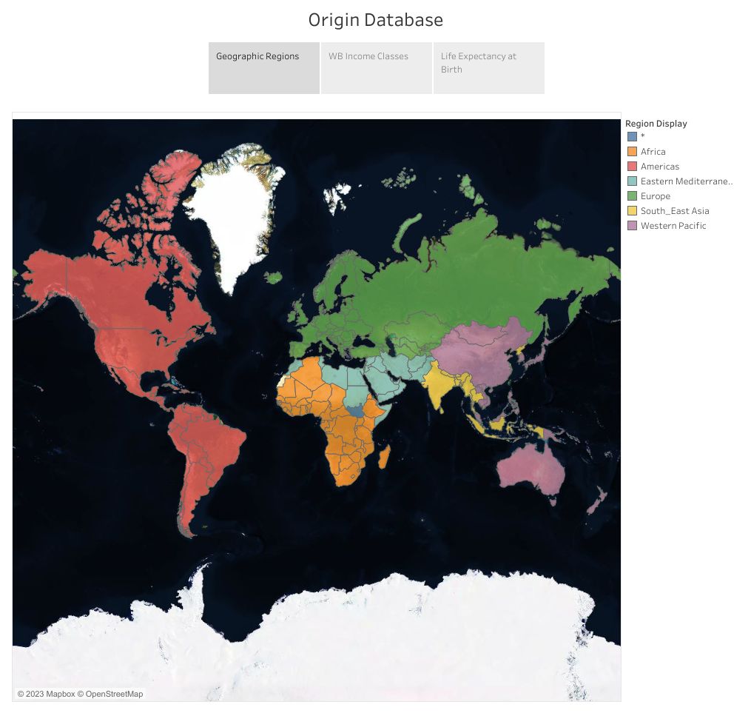
Life Expectancy vs Alcohol Consumption

Slide 11
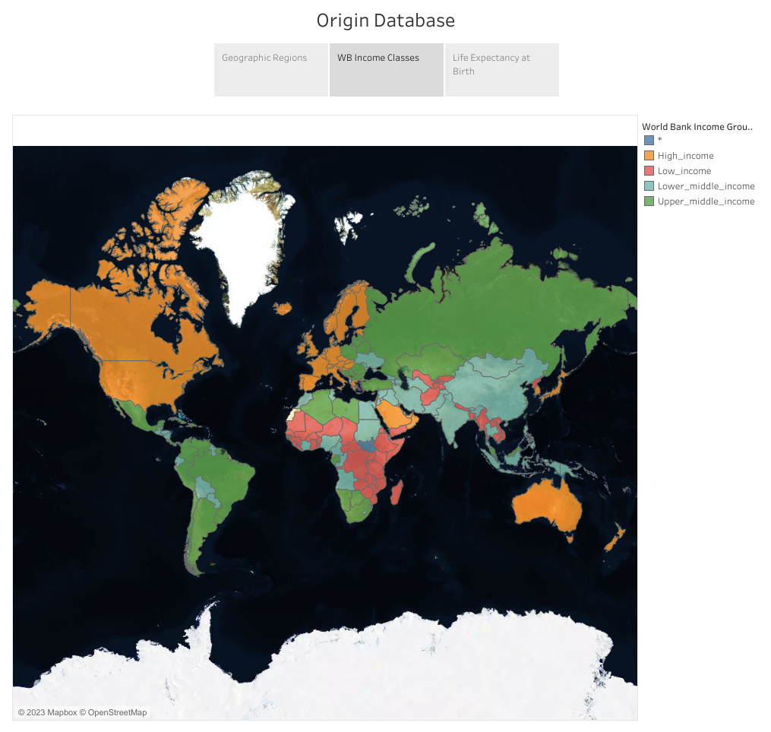
Life Expectancy vs Alcohol Consumption

Slide 12
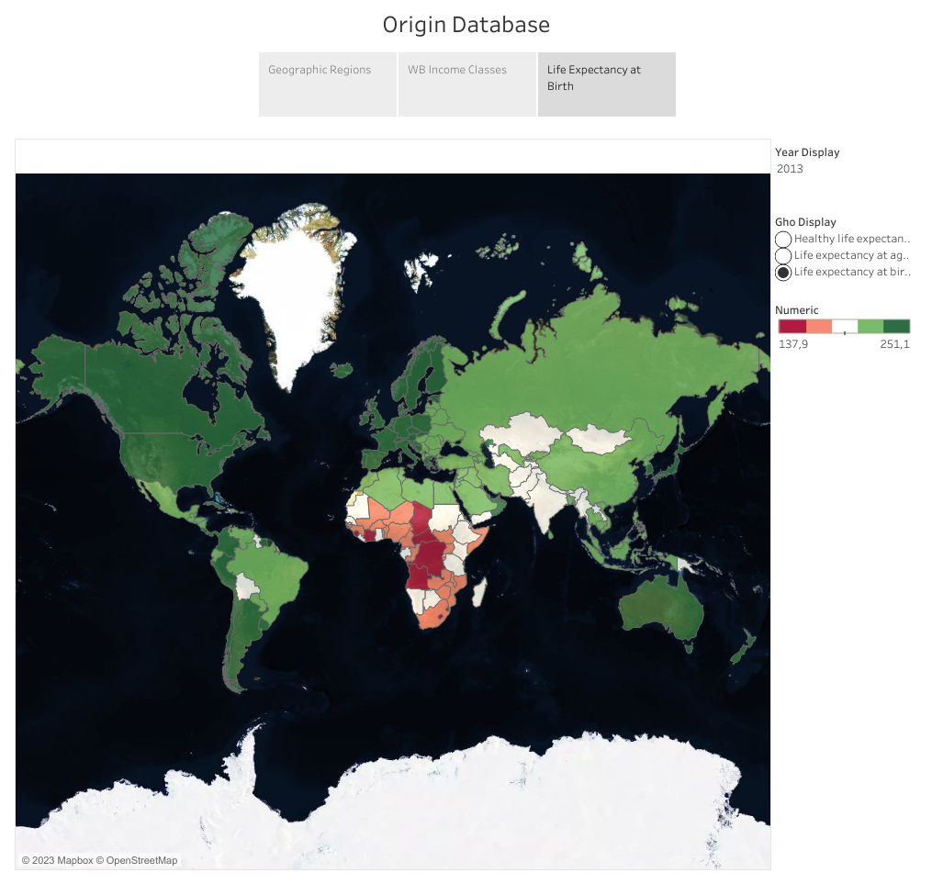
Life Expectancy vs Alcohol Consumption

Slide 13
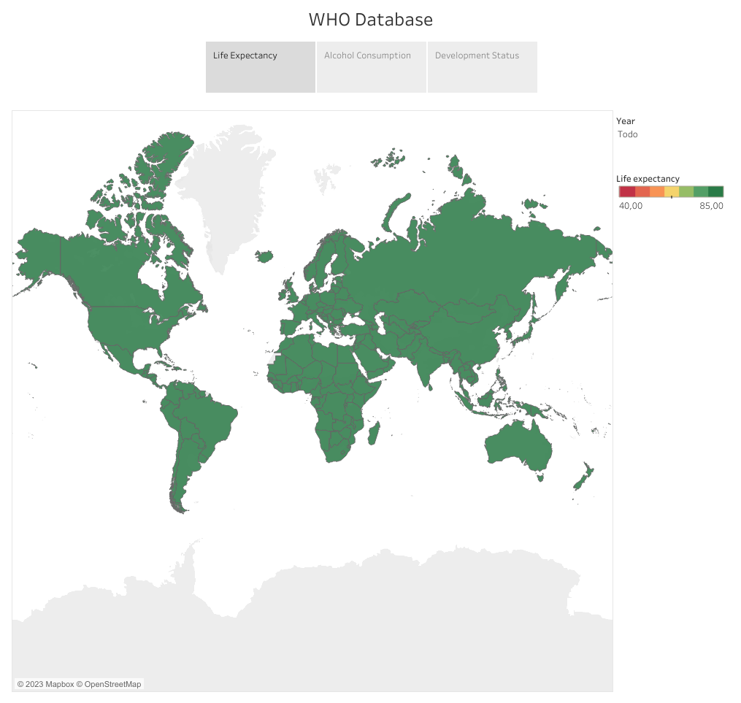
Life Expectancy vs Alcohol Consumption

Slide 14
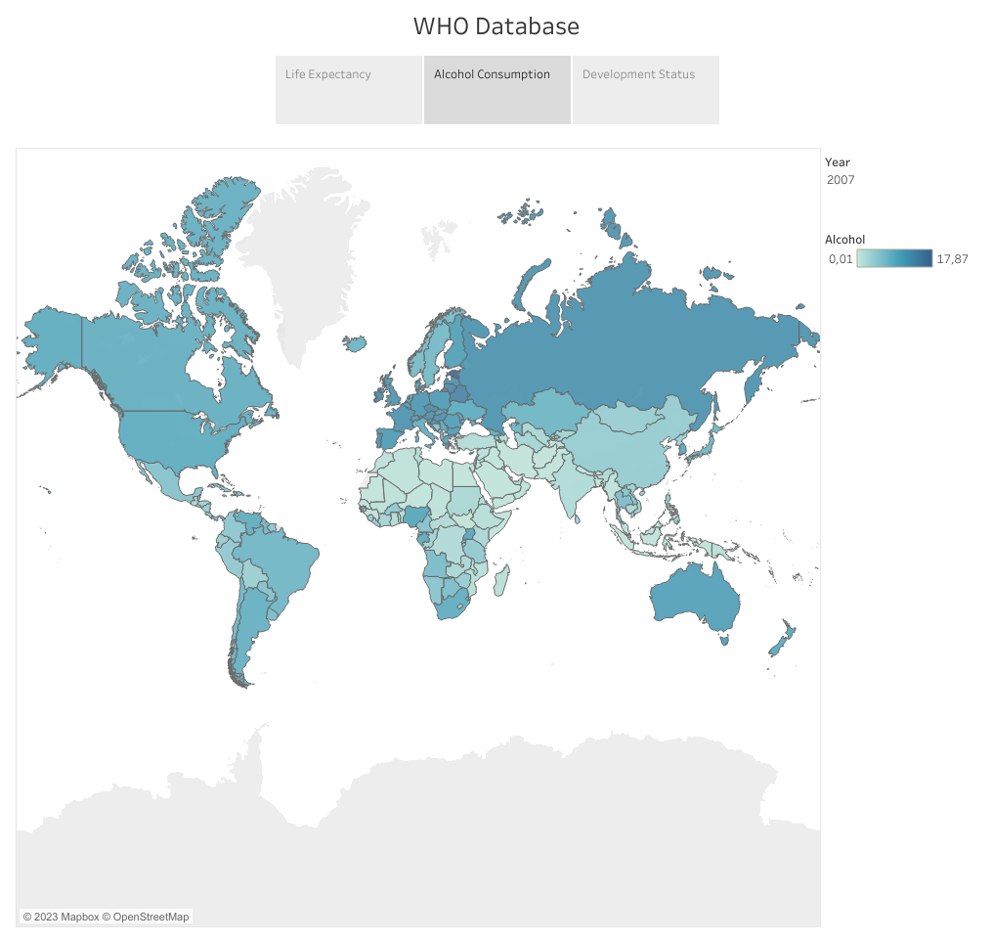
Life Expectancy vs Alcohol Consumption

Slide 15
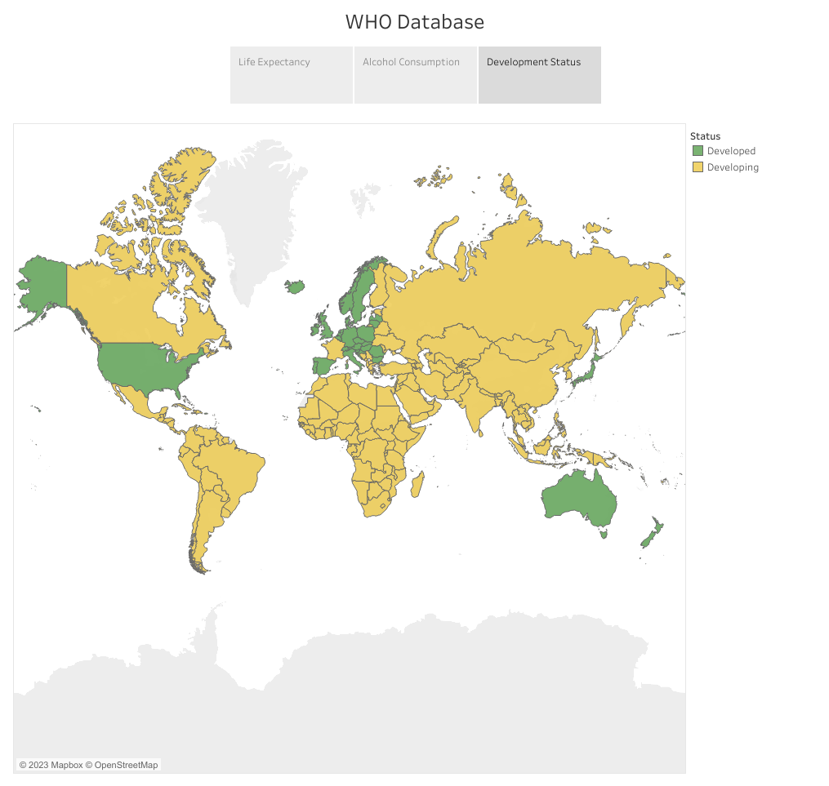
Life Expectancy vs Alcohol Consumption

Slide 16
Dashboard
Dashboard
Machine Learning
Conclusion

Slide 17
Machine Learning
Machine Learning goal:
Data used:
We merged two tables Life_Expectancy_WHO and lifeexpectancy-verbose
And these variables ----
Models we tried:
Multiple Linear Regression
Neural Networks
Dashboard
Machine Learning
Conclusion

Slide 18
Machine Learning
Dashboard
Machine Learning
Conclusion

Slide 19
Machine Learning Results
Dashboard
Machine Learning
Conclusion

Slide 20
Conclusion
Machine Learning
Dashboard
Conclusion

